Slide 1
JD+ 3.0 Core algorithms
ESTP Training

Slide 2
1. What’s new in JD+ 3.0?
Additional time series domains
New concepts
Design
API / implementation / IO
New algorithms
Enhanced interaction with external tools/technologies
New R packages

Slide 3
2. JDemetra 3.0 New design
TramoSeats
X13
Toolkit-SA
STL
SA-experimental
Benchmarking
High-frequency
Demetra
Toolkit
STS
BusinessCycle
Nowcasting
RevisionsAnalysis
Calendars

Slide 4
Demetra Toolkit
Toolkit-IO
Toolkit-R
Toolkit-API
Toolkit-Core
Toolkit-Basic
Toolkit-Modelling
Toolkit-Ssf
Toolkit-RegArima

Slide 5
3. Main blocks (I)
Toolkit: low-level algorithms
Matrices, polynomials, optimization, stats, distributions, time series, calendars, …
ARIMA modelling, ssf, , RegArima…
Toolkit-SA:
Generic SA routines (diagnostics…)
TramoSeats, X13
STL
Experimental modules
High-frequency, alternative filters

Slide 6
3. Main blocks (II)
STS (structural time series)
Toolkit-Benchmarking
Business cycle
HP, Modified HP
Nowcasting (TODO)
DFM…
Calendars
Moving holidays, special calendars (Chinese…)
Revisions analysis
->Eurostat

Slide 7
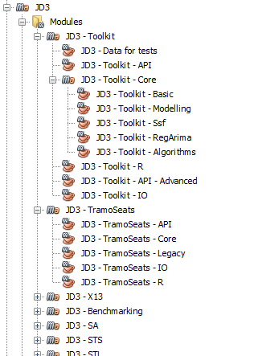
4. JDemetra 3.0. New design (cont.)
30 projects
Separate release schedules
> 150 modules
In progress
Graphical interfaces
JD+ GUI (RC available)
Plug-ins
R modules
WEB-services

